Slide 1
Comparators
Introduction
A comparator is an electronic circuit, which compares the two inputs that are applied to it and produces an output.
The output value of the comparator indicates which of the inputs is greater or lesser.
Comparator falls under non-linear applications of ICs.
Types of Comparators
Comparators are of two types :
Inverting Comparators
Non-inverting Comparators

Slide 2
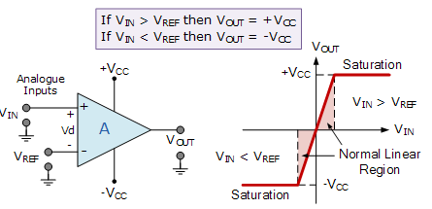
Comparators
Introduction
V_{IN} is less than the DC voltage level at V_{REF}, ( V_{IN} < V_{REF} ). As the non-inverting (positive) input of the comparator is less than the inverting (negative) input, the output will be LOW and at the negative supply voltage, -Vcc resulting in a negative saturation of the output.
If we now increase the input voltage, V_{IN} so that its value is greater than the reference voltage V_{REF} on the inverting input, the output voltage rapidly switches HIGH towards the positive supply voltage, +Vcc resulting in a positive saturation of the output.

Slide 3
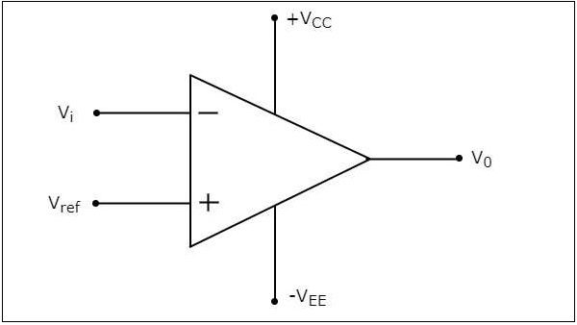
Comparators
Inverting Comparator
An inverting comparator is an op-amp based comparator for which a reference voltage is applied to its non-inverting terminal and the input voltage is applied to its inverting terminal.
The operation of an inverting comparator is very simple. It produces one of the two values, +V_{sat} and −V_{sat} at the output based on the values of its input voltage V_{i} and the reference voltage V_{ref}.

Slide 4
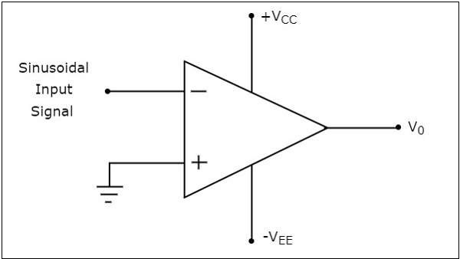
Comparators
Inverting Comparator
The operation of an inverting comparator is very simple. It produces one of the two values, +V_{sat} and −V_{sat} at the output based on the values of its input voltage V_{i} and the reference voltage V_{ref}.
The output value of an inverting comparator will be −V_{sat}, for which the input V_{i} voltage is greater than the reference voltage V_{ref}.
The output value of an inverting comparator will be +V_{sat}, for which the input V_{i} is less than the reference voltage V_{ref}.

Slide 5
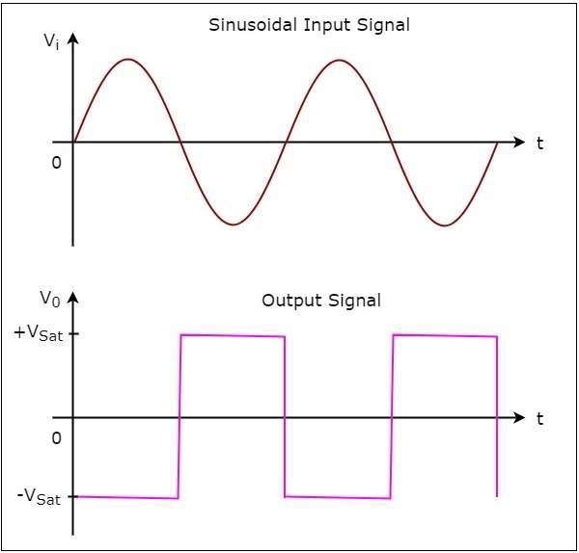
Comparators
Inverting Comparator
The operation of the inverting comparator is;
During the positive half cycle of the sinusoidal input signal, the voltage present at the inverting terminal of op-amp is greater than zero volts. Hence, the output value of the inverting comparator will be equal to −V_{sat} during positive half cycle of the sinusoidal input signal.
Similarly, during the negative half cycle of the sinusoidal input signal, the voltage present at the inverting terminal of the op-amp is less than zero volts. Hence, the output value of the inverting comparator will be equal to +V_{sat} during negative half cycle of the sinusoidal input signal.
The output transitions either from −V_{sat} to +V_{sat} or from +V_{sat} to −V_{sat}.
Output changes its value when the input is crossing zero volts.
Hence, the above circuit is also called as inverting zero crossing detector.

Slide 6
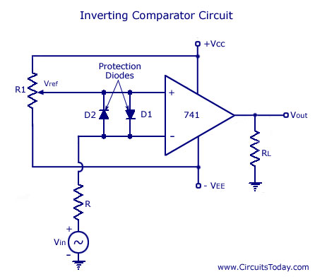
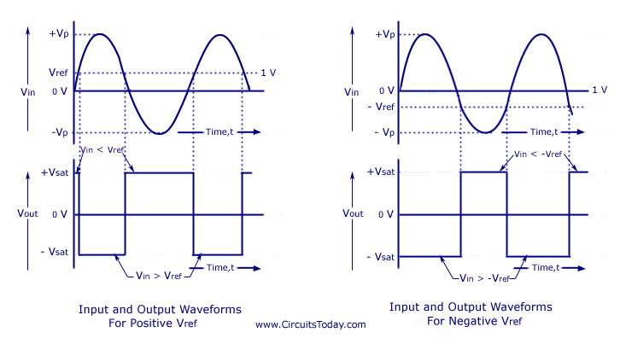
Comparators
Inverting Comparator

Slide 7
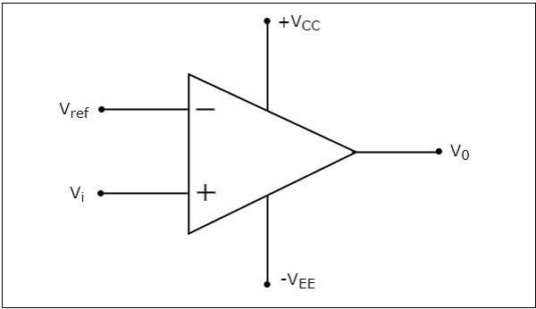
Comparators
Non-Inverting Comparator
A non-inverting comparator is an op-amp based comparator for which a reference voltage is applied to its inverting terminal and the input voltage is applied to its non-inverting terminal.
This op-amp based comparator is called as non-inverting comparator because the input voltage, which has to be compared is applied to the non-inverting terminal of the op-amp.

Slide 8
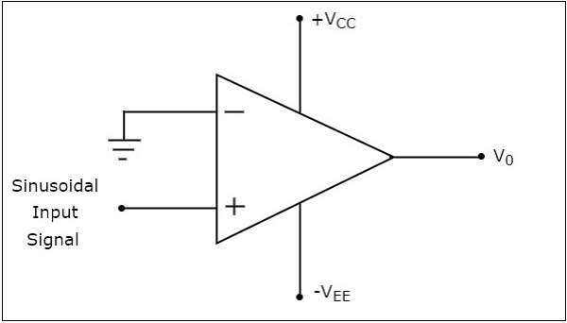
Comparators
Non-Inverting Comparator - operation
It produces one of the two values, +V_{sat} and −V_{sat} at the output based on the values of input voltage Vt and the reference voltage +V_{ref}.
.
The output value of a non-inverting comparator will be +V_{sat} , for which the input voltage Vi is greater than the reference voltage +V_{ref}.
The output value of a non-inverting comparator will bee −V_{sat}, for which the input voltage Vi is less than the reference voltage +V_{ref}.

Slide 9
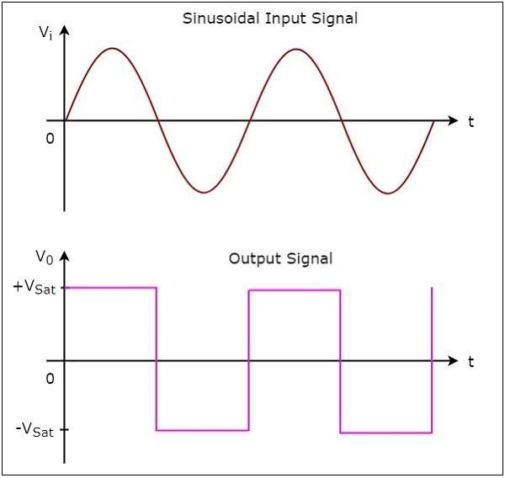
Comparators
Non-Inverting Comparator - operation
During the positive half cycle of the sinusoidal input signal, the voltage present at the non-inverting terminal of op-amp is greater than zero volts. Hence, the output value of a non-inverting comparator will be equal to +V_{sat} during the positive half cycle of the sinusoidal input signal.
Similarly, during the negative half cycle of the sinusoidal input signal, the voltage present at the non-inverting terminal of op-amp is less than zero volts. Hence, the output value of non-inverting comparator will be equal to −V_{sat} during the negative half cycle of the sinusoidal input signal.
The output transitions either from +Vsat to −V_{sat} or from −V_{sat} to +V_{sat}
The output changes its value when the input is crossing zero volts.
Hence, the above circuit is also called as non-inverting zero crossing detector.

Slide 10
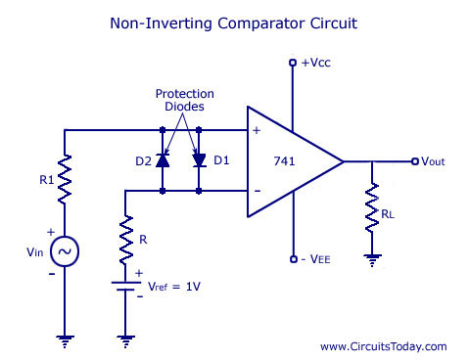
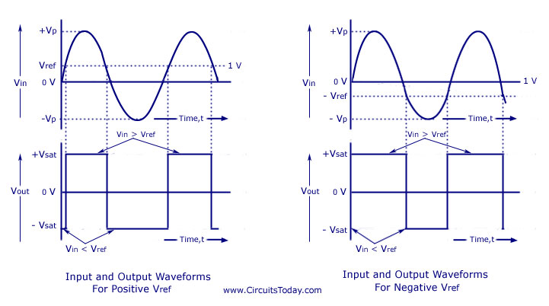
Comparators
Non-Inverting Comparator - operation

Slide 11
Comparators
Comparator - Applications
Zero crossing detector
Window Detector
Time Marker generator
Phase meter
Schmitt trigger

Slide 12
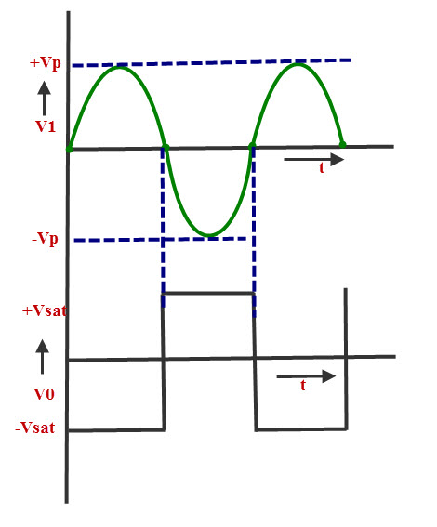
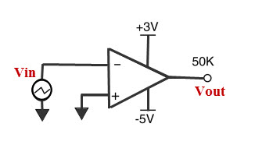
Comparators
Comparator – Zero crossing detector

Slide 13
Comparators
Comparator – Window Detector
A Window Comparator is basically the inverting and the non-inverting comparators above combined into a single comparator stage.
The window comparator detects input voltage levels that are within a specific band or window of voltages.
Using our idea above of a voltage divider network, if we now use three equal value resistors so that R₁ = R₂ = R₃ = R.
So as the resistive values are all equal, the voltage drops across each resistor will also be equal at one-third the supply voltage, 1/3Vcc.
So for ease in this simple window comparator example, we can set the upper reference voltage to 2/3Vcc and the lower reference voltage to 1/3Vcc.

Slide 14
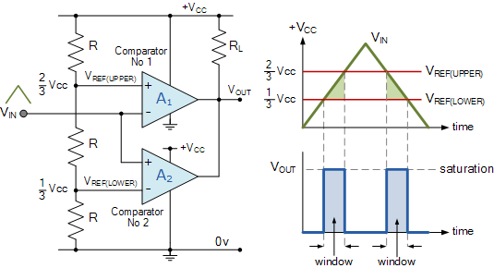
Comparators
Comparator – Window Detector

Slide 15
Comparators
Comparator – Window Detector
The inital switching condition of the circuit is the open-collector output of op-amp A₁ “OFF” with the open-collector output of op-amp A₂, “ON” (sinking current) so V_{OUT} is equal to 0V.
When V_{IN} is below the lower voltage level, V_{REF(LOWER)} which equates to 1/3Vcc, V_{OUT} will be LOW. When V_{IN} exceeds this 1/3Vcc lower voltage level, the first op-amp comparator detects this and switches its open-collector output HIGH. This means that both op-amps have their outputs HIGH at the same time. No current flows through the pull-up resistor R_{L} so V_{OUT} is equal to Vcc.
As V_{IN} continues to increase it passes the upper voltage level, V_{REF(UPPER)} at 2/3Vcc. At this point the second op-amp comparator detects this and switches its output LOW and V_{OUT} becomes equal to 0V.
Then the difference between V_{REF(UPPER)} and V_{REF(LOWER)} (which is 2/3Vccc – 1/3Vcc in this example) creates the switching window for the positive going signal.
Lets now assume that V_{IN} is at its maximum value and equal to Vcc. As V_{IN} decreases it passes the upper voltage level V_{REF(UPPER)} of the second op-amp comparator which switches the output HIGH. As V_{IN} continues to decrease it passes the lower voltage level, V_{REF(LOWER)} of the first op-amp comparator once again switching the output LOW.
Then the difference between V_{REF(UPPER)} and V_{REF(LOWER)} creates the window for the negative going signal. So we can see that as V_{IN} passes above or passes below the upper and lower reference levels set by the two op-amp comparators, the output signal V_{OUT} will be HIGH or LOW.

Slide 16
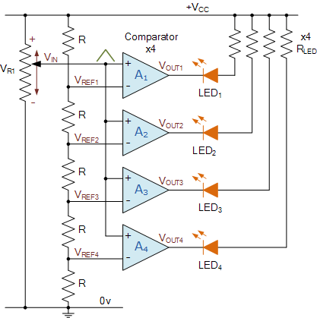
Comparators
Comparator – Window Detector
Comparator Voltage Level Detector

Slide 17
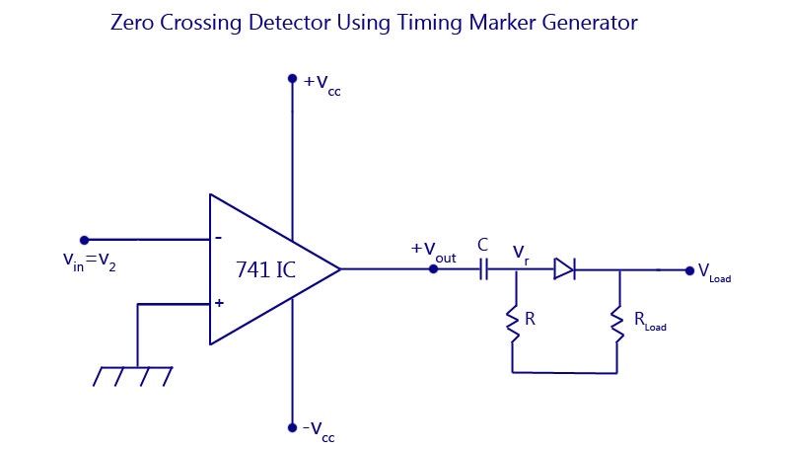
Comparators
Comparator – Time Marker Generator

Slide 18
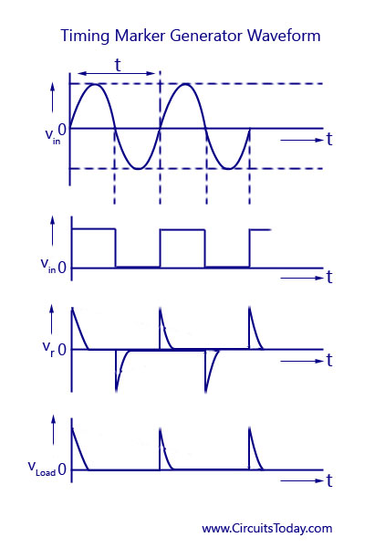
Comparators
Comparator – Time Marker Generator

Slide 19
Comparators
Comparator – Phase meter / Phase Detector
A zero-crossing detector can be used for the measurement of phase angle between two voltages.
The working will be the same as explained in the Time Marker circuit.
A train of pulses in the positive and negative cycles are obtained and the time interval between the pulse of sine wave voltage and that of second sine wave voltage is measured.
This interval of time is proportional to the phase difference between the two input sine wave voltages. The range of use of phasemeter for measurement is 0° to 360°.

Slide 20
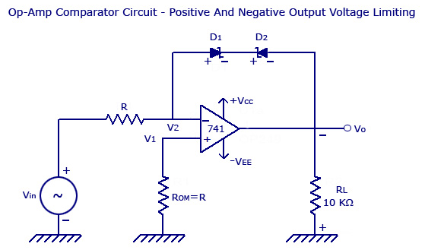
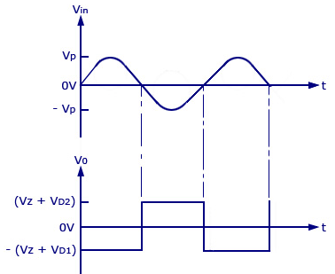
Comparators
Comparator – Voltage Limiter Circuit Using Op-amp

Slide 21
Comparators
Comparator – Voltage Limiter Circuit Using Op-amp
At this condition, V₀ = V_{Z} + V_{D1}
V_{Z} – Zener Voltage
V_{D1} – Voltage drop across D1 = 0.7V
If Vo increases from 0 to negative voltage, Vo increases positively until diode D2 is forward biased and D1 goes into avalanche condition.
A t this condition, V₀ = V_{Z} + V_{D2}
V_{Z} – Zener Voltage
V_{D1} – Voltage drop across D₂ = 0.7V
Thus the limit of output voltage swing is between +(V_{Z} + 0.7) and –(V_{Z} + 0.7).
When V_{in} ranges from 0 to positive voltage, D2 is reverse biased and thus V0 = -V_{sat}.
When V_{in} ranges from 0 to negative voltage, D2 is forward biased and D1 goes into avalanche condition.
Thus V0 = V_{Z} + V_{D2}.

Slide 22
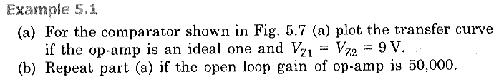
Comparators
Comparator – Voltage Limiter Circuit Using Op-amp

Slide 23
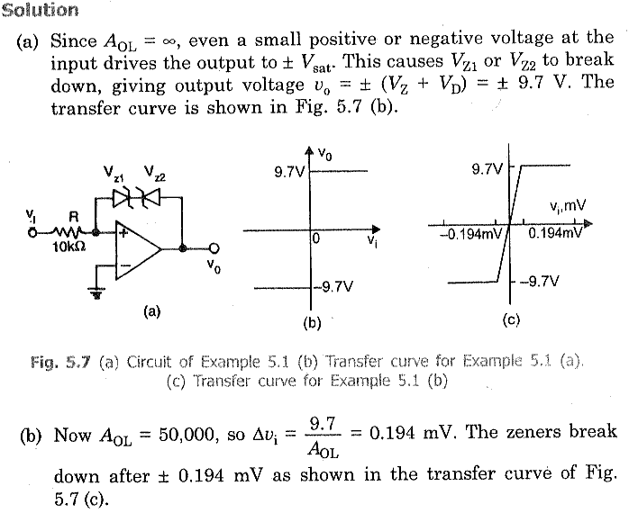
Comparators
Comparator – Voltage Limiter Circuit Using Op-amp

Slide 24
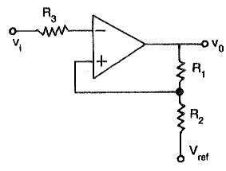
SCHMITT Trigger
Circuit Diagram
Node ‘A’
A Schmitt trigger circuit is also called a regenerative comparator circuit.
It is basically an inverting comparator circuit with a positive feedback.

Slide 25
SCHMITT Trigger
Operation
In an Inverting Schmitt Trigger, the input is applied to the inverting terminal of the Op-Amp.
In this mode, the output produced is of opposite polarity.
This output is applied to non-inverting terminal to ensure positive feedback V_{ref}= (βA_{OL}). A_{OL} is the Open Loop Gain of Op-Amp.
When V_{IN} is slightly greater than V_{A}, the output becomes -V_{SAT} and if V_{IN} is slightly less that -V_{A} (more negative than -V_{REF}), then output becomes V_{SAT}.
Hence, the output voltage V_{O} is either at V_{SAT} or -V_{SAT} and the input voltage at which these state changes occur can be controlled using R₁ and R₂.
The reference voltage V_{REF} and -V_{REF} are called Upper Threshold Voltage V_{UT} and Lower Threshold Voltage V_{LT}.

Slide 26
SCHMITT Trigger
Analysis
Assume initially, the output V₀= +V_{SAT,} then apply nodal analysis at V_{A},
(V_{A}-V_{REF})/R₂ + (V_{A}-V_{SAT})/R₁ = 0 ----(1)
V_{A} = (R₁R₂/R₁+R₂) [V_{REF}/R₂+V_{SAT}/R₁]
Thus, V_{UT} = (1/R₁+R₂)[R₁V_{REF}+R₂V_{SAT}] ----(2)
Similarly, if the output V₀= -V_{SAT,} then apply nodal analysis at V_{A},
(V_{A}-V_{REF})/R₂ + (V_{A}+V_{SAT})/R₁ = 0 ----(3)
V_{A} = (R₁R₂/R₁+R₂) [V_{REF}/R₂-V_{SAT}/R₁]
Thus, V_{LT} = (1/R₁+R₂)[R₁V_{REF}-R₂V_{SAT}] ----(4)

Slide 27
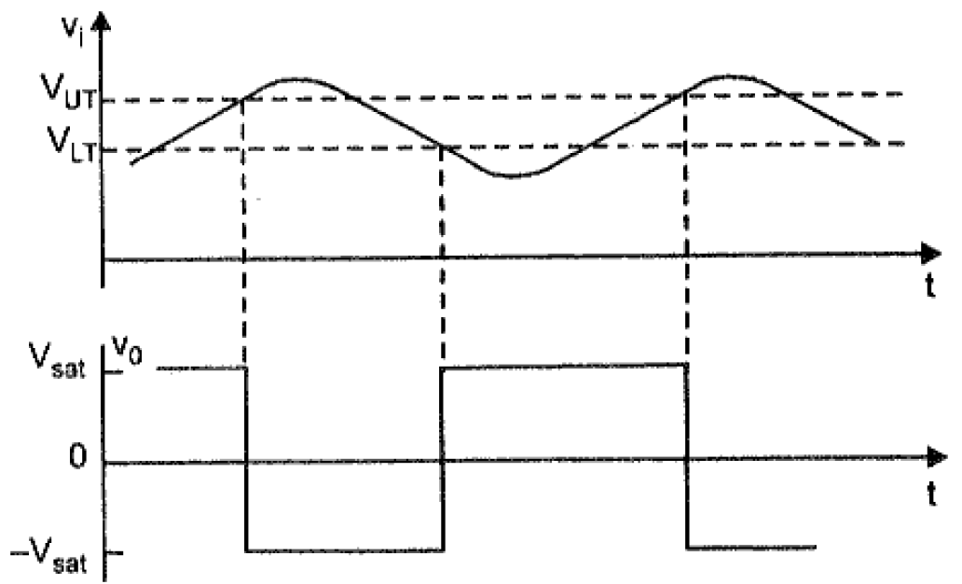
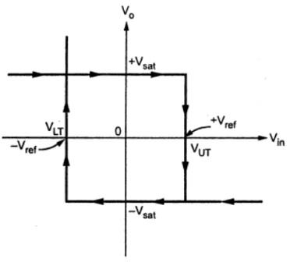
SCHMITT Trigger
Analysis
From eqn. (2) and eqn. (4),
Hysteresis V_{H} = V_{UT} – V_{LT} = (2R₂V_{SAT} /R₁+R₂)
Transfer Characteristic of Schmitt Trigger

Slide 28
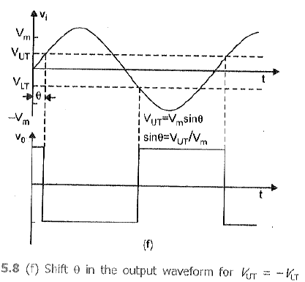
SCHMITT Trigger
Analysis
Consider V_{REF} = 0V then eqn. (2) and eqn. (4) becomes,
V_{UT} = – V_{LT} = (R₂V_{SAT} /R₁+R₂)

Slide 29
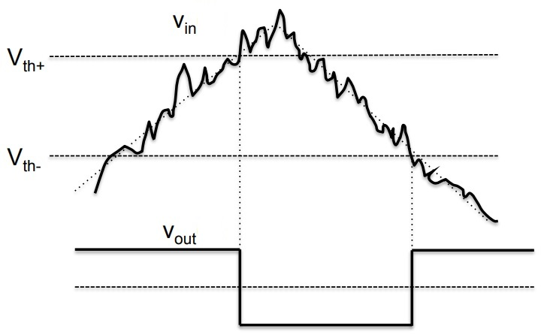
SCHMITT Trigger
Application
One important application of Schmitt Trigger is to convert Sine waves into Square waves.
They can be used to eliminate chatter in Comparators (a phenomenon where multiple output transitions are produced due to swinging of input signal through the threshold region).
They can also act as simple ON / OFF Controllers (for example, temperature based switches).
If we have a noisy input signal as shown figure, the two thresholds of the Schmitt Trigger Circuit will correctly determine the square pulses.
Hence, the basic function of a Schmitt Trigger is to convert noisy square, sine, triangular or any periodic signals into clean square pulses with sharp leading and trailing edges

Slide 30
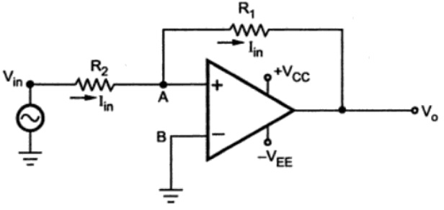
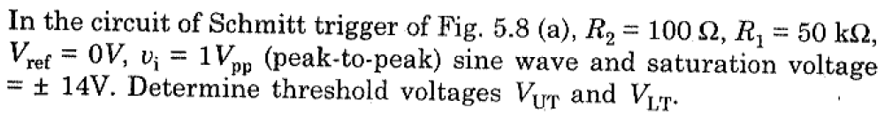
SCHMITT Trigger
Non-Inverting Schmitt Trigger Circuit
Problem

Slide 31
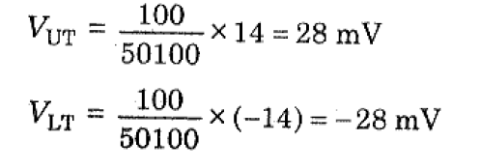
SCHMITT Trigger
Problem

Slide 32
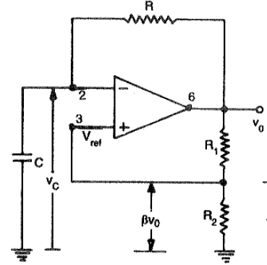
Astable Multivibrator
Circuit Diagram

Slide 33
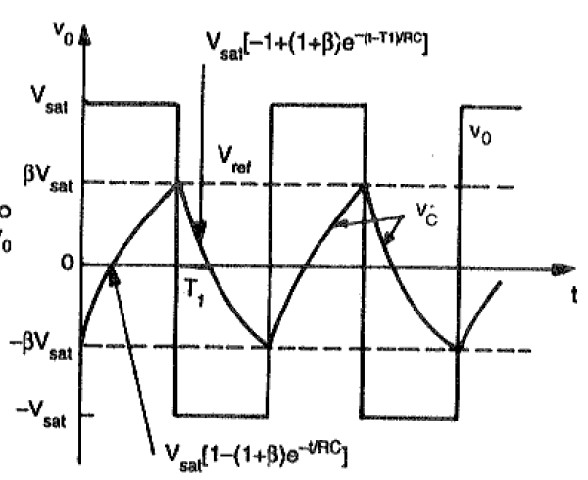
Astable Multivibrator
Output Waveform

Slide 34
Astable Multivibrator
Operation
Firstly lets assume that the capacitor is fully discharged and the output of the op-amp is saturated at the positive supply rail.
The capacitor, C starts to charge up from the output voltage, Vout through resistor, R at a rate determined by their RC time constant.
RC circuits that the capacitor wants to charge up fully to the value of Vout (which is +V(sat)) within five time constants.
However, as soon as the capacitors charging voltage at the op-amps inverting (-) terminal is equal to or greater than the voltage at the non-inverting terminal (the op-amps output voltage fraction divided between resistors R1 and R2), the output will change state and be driven to the opposing negative supply rail.

Slide 35
Astable Multivibrator
Operation
Once the op-amps inverting terminal reaches the new negative reference voltage, -Vref at the non-inverting terminal, the op-amp once again changes state and the output is driven to the opposing supply rail voltage, +V(sat).
The capacitor now see’s a positive voltage across its plates and the charging cycle begins again. Thus, the capacitor is constantly charging and discharging creating an astable op-amp multivibrator output.

Slide 36
Astable Multivibrator
Operation
When power is turned ON, V₀ automatically swings either +V_{sat} or to –V_{sat} since these are the only stable states allowed by Schmitt trigger. Assume it swings to +V_{sat}.
Now capacitor starts charging towards +V_{sat} through the feedback path provided by the resistor R to the inverting input. As long as the capacitor voltage V_{c} is less than +βV_{sat}, the output voltage remains at +V_{sat}
As soon as V_{c} charges to a value slightly greater than +βV_{sat}, the input goes positive with respect to the input. This switches the output voltage from +V_{sat} to -V_{sat}
As V₀ switches to -V_{sat}, capacitor starts discharging via . The current I discharges capacitor to 0 V and recharges capacitor to –βV_{sat.} When V_{c} becomes slightly more negative than the feedback voltage –βV_{sat,} output voltage switches back to +V_{sat}

Slide 37
Astable Multivibrator
Analysis
Voltage across Capacitor at time t is given by the eqn. as
V_{c}(t) = V_{f} + (V_{i} - V_{f}) e^{(-t/RC)} ----(1)
Where V_{f} is Final Value = +V_{sat}
V_{i} is Initial Value = -βV_{sat}
V_{c}(t) = +V_{sat} + (-βV_{sat} - V_{sat}) e^{(-t/RC)} ----(2)
V_{c}(t) = +V_{sat} - V_{sat}(1+β) e^{(-t/RC)} ----(3)
At t= T₁, then V_{c} = +βV_{sat} and Switching Takes place, therefore,
V_{c}(T₁) = βV_{sat} = +V_{sat} - V_{sat}(1+β) e^{(-T}₁^{/RC)} ----(4)

Slide 38
Astable Multivibrator
Analysis
Solving eqn. (4) gives,
T₁ = RC ln ((1+β)/(1-β)) ----(5)
eqn. (5) for half a cycle, for full cycle,
T = 2T₁ = 2RC ln ((1+β)/(1-β)) ----(6)
If R₁=R₂ then, β = 0.5,
T = 2RC ln 3 ----(7)
If R₁=1.16R₂ then,
T = 2RC ----(8)
f = 1/2RC ----(9)
V_{pp} = 2V_{sat} ----(10)

Slide 39
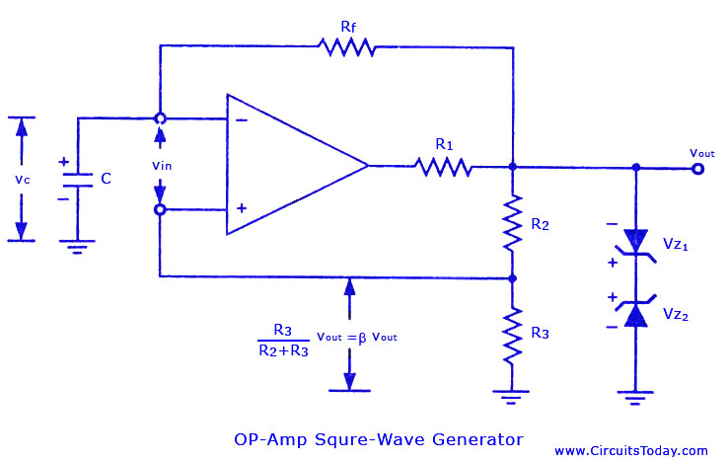
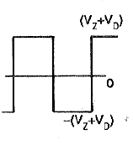
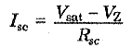
Astable Multivibrator
Analysis

Slide 40
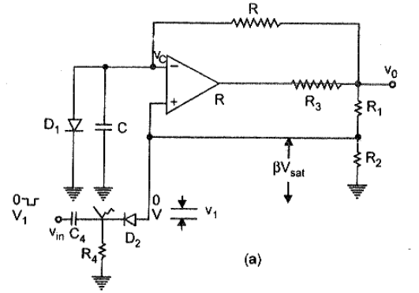
Monostable Multivibrator
Circuit Diagram

Slide 41
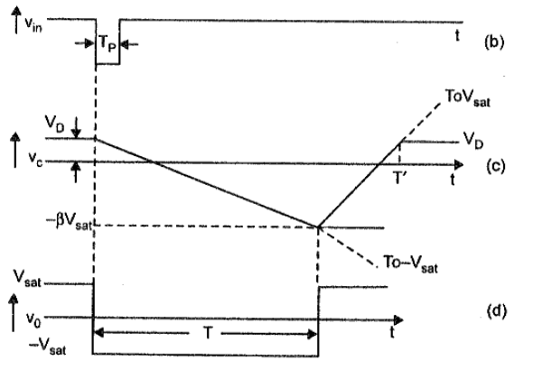
Monostable Multivibrator
Output Waveforms

Slide 42
Monostable Multivibrator
Operation
The monostable multivibrator is also called as
One-shot multivibrator
Time delay circuit
Gating Circuit
The circuit produces a single pulse of specified duration in response to each external trigger signal. For such a circuit, only one stable state exists.
When an external trigger is applied, the output changes its state. The new state is called as a quasi-stable state. The circuit remains in this state for a fixed interval of time. After some time it returns back to its original stable state.
In fact, an internal trigger signal is generated which drives the circuit back to its original stable state. Usually, the charging and discharging of a capacitor provide this internal trigger signal.

Slide 43
Monostable Multivibrator
Operation
The diode D₁ connected across the capacitor is called clamping diode. It clamps the capacitor voltage to 0.7V when the output is at +V_{sat}.
A negative triggering pulse is applied to the Non-inverting terminal of Op-amp through RC differentiator circuit and diode D₂.
To understand the operation of the circuit, let us assume that the output V₀ is at +V_{sat} i.e. in its stable state.
The diode D₁ (Connected across Capacitor) conducts and the voltage across the capacitor C => V_{C} gets clamped to 0.7V Volts.
The voltage at the non-inverting terminal is controlled by voltage divider circuit of R₁ and R_{2.}
Voltage at non-inverting terminal (V₂) = βV₀ {where, β= (R₂/(R₁+R₂))}

Slide 44
Monostable Multivibrator
Operation
If V₁, a negative trigger of amplitude V₁ is applied to the non-inverting terminal, so that the effective voltage at this terminal is less than 0.7V. Then the output of the Op-amp changes its state from +V_{sat} to -V_{sat.}
The diode is now reverse biased and the capacitor starts charging exponentially to -V_{sat} through resistance R.
The voltage at the non-inverting terminal is now -βV₀.When the capacitor voltage becomes just slightly more negative than -βV_{0,} the output of the Op-amp changes its state back to +V_{0.}
The capacitor now starts charging towards +V₀ through R until V_{C} reaches 0.7V as capacitor gets clamped to the voltage.

Slide 45
Monostable Multivibrator
Analysis
Voltage across Capacitor at time t is given by the eqn. as
V_{c}(t) = V_{f} + (V_{i} - V_{f}) e^{(-t/RC)} ----(1)
Where V_{f} is Final Value = -V_{sat}
V_{i} is Initial Value = V_{D1}
V_{c}(t) = -V_{sat} + (V_{D1} + V_{sat}) e^{(-t/RC)} ----(2)
At t= T, then V_{c} = -βV_{sat} and Switching Takes place, therefore,
V_{c}(T) = --βV_{sat} = -V_{sat} (V_{D1} + V_{sat}) e^{(-T/RC)} ----(3)

Slide 46
Monostable Multivibrator
Analysis
Solving eqn. (3) gives,
T₁ = RC ln ((1+V_{D1}/V_{sat})/(1-β)) ----(4)
where, β= (R₂/(R₁+R₂))
If V_{sat} >> V_{D1} and R₁=R₂ then, β = 0.5,
T = 0.69 RC ----(5)

Slide 47
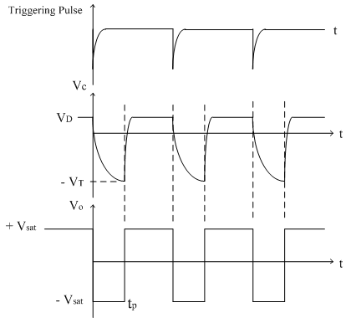
Monostable Multivibrator
NOTE:
For Monostable operation, the trigger pulse width T_{p} should be much less than T.
The diode D₂ is not essential but it is used to avoid malfunctioning if any positive noise spikes are present in triggering line.
It can be seen from the waveform that the voltage V_{C} does not reach its quiescent value V_{D1} until time T’>T. Hence it is necessary that a recovery time (T’>T) be allowed to elapse before the next triggering signal is applied.

Slide 48
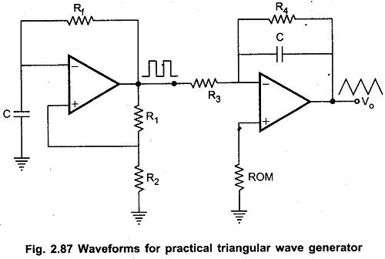
Triangular wave Generator
Method:1
Circuit Diagram

Slide 49
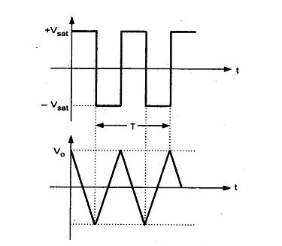
Triangular wave Generator
Method:1
Circuit Diagram

Slide 50
Triangular wave Generator
Method:1
Operation
Basically, triangular wave is generated by alternatively charging and discharging a capacitor with a constant current.
This is achieved by connecting integrator circuit at the output of square wave generator. Assume that V’ is high at +V_{sat}.
This forces a constant current (+V_{sat} / R₃) through C (left to right) to drive V_{o} negative linearly.
When V’ is low at -V_{sat}, it forces a constant current (-V_{sat} / R₃) through C (right to left) to drive V_{o} positive, linearly.
The frequency of the triangular wave is same as that of square wave.
Although the amplitude of the square wave is constant (±V_{sat}), the amplitude of the triangular wave decreases with an increase in its frequency, and vice versa.
This is because the reactance of capacitor decreases at high frequencies and increases at low frequencies.
In practical circuits, resistance R₄ is connected across C to avoid the saturation problem at low frequencies as in the case of practical integrator

Slide 51
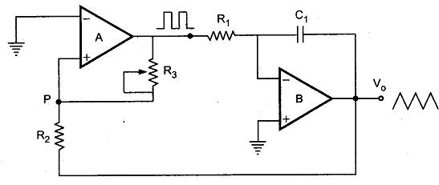
Triangular wave Generator
Method:2
Circuit Diagram
Another triangular wave generator, which requires fewer components

Slide 52
Triangular wave Generator
Method:2
Operation
It consists of a comparator (A) and an integrator (B).
The output of comparator A is a square wave of amplitude ± V_{sat} and is applied to the inverting (-) input terminal of the integrator B.
The output of integrator is a triangular wave and it is feedback as input to the comparator A through a voltage divider R₂ R₃.
To understand circuit operation, assume that the output of comparator A is at + V_{sat} .
This forces a constant current (+ V_{sat} / R₁) through C to give a negative going ramp at the output of the integrator, as shown in the Fig..
Therefore, one end of voltage divider is at a voltage +V_{sat} and the other at the negative going ramp.
When the negative going ramp reaches a certain value -V_{ramp}, the effective voltage at point P becomes slightly below 0V.

Slide 53
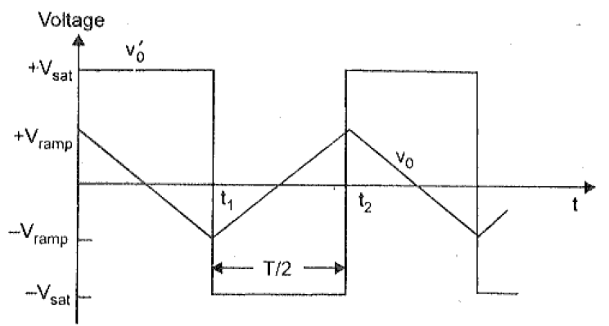
Triangular wave Generator
Method:2
Output waveform

Slide 54
Triangular wave Generator
Method:2
Operation
As a result, the output of comparator A switches from positive saturation to negative saturation (-V_{sat}).
This forces a reverse constant current (right to left) through C to give a positive going ramp at the output of the integrator, as shown in the Fig.
When positive going ramp reaches + V_{ramp}, the effective voltage at point P becomes slightly above 0V.
As a result, the output of comparator A switches from negative saturation to positive saturation (+V_{sat}).
The sequence then repeats to give triangular wave at the output of integrator B.

Slide 55
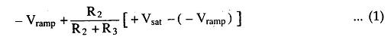
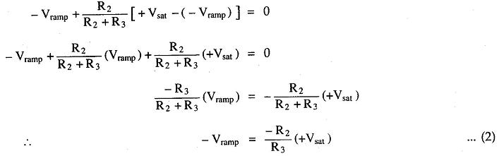
Triangular wave Generator
Method:2
Amplitude and Frequency Calculation
When comparator output is at +V_{sat}, the effective voltage at point P is given by
When effective voltage at P becomes equal to zero, we can write above equation

Slide 56
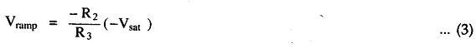
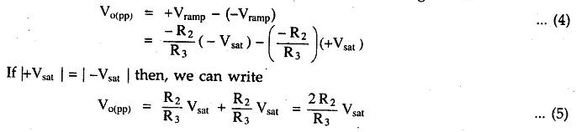
Triangular wave Generator
Method:2
Amplitude and Frequency Calculation
Similarly, when comparator output is at -V_{sat ,}we can write,
The peak to peak amplitude of the triangular wave can be given as

Slide 57
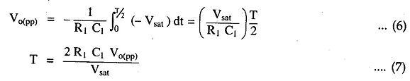
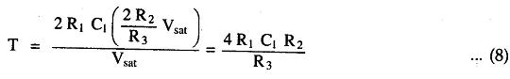
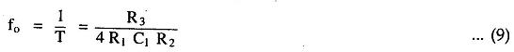
Triangular wave Generator
Method:2
Amplitude and Frequency Calculation
The time taken by the output to swing from – V_{ramp} to + V_{ramp} (or from + V_{ramp} to – V_{ramp}) is equal to half the time period T/2
Substituting value of V_{o(pp)} we get,
Therefore, the frequency of oscillation can be given as,

Slide 58
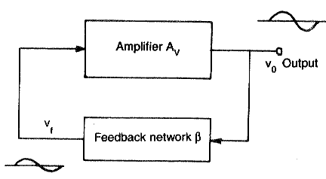
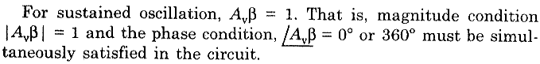
Sine wave Generator
Barkhausen criteria
Electronic oscillators are divided into:
Sinusoidal (or harmonic) oscillators-which produce an output having sine waveform
Non-sinusoidal (or relaxation) oscillator-the output is square, rectangular or saw-tooth or pulse shape.
A(jω)β(jω) = 1(0°)
The total phase shift of the loop gain should be Zero ro multiple of 2Π.
The magnitude of the loop gain Aβ is equal to unity |Aβ| = 1.

Slide 59
Sine wave Generator
Types of Oscillators
There are two types,
RC Phase Shift Oscillators - Audio Frequencies (Hz to kHz)
LC Oscillators – High Frequencies (in MHz)

Slide 60


RC Phase Shift Oscillators
Circuit Diagram

Slide 61
RC Phase Shift Oscillators
Description
R-C phase shift oscillator using op-amp uses an op-amp in inverting amplifier mode. Thus it introduces the phase shift of 180° between input and output. The feedback network consists of 3 RC sections each producing 60° phase shift.
The output of the amplifier is given to the feedback network. The output of the feedback network drives the amplifier. The total phase shift around a loop is 180° of the amplifier and 180° due to 3 RC section, thus 360°. This satisfies the required condition for positive feedback and circuit works as an oscillator.
The gain of the amplifier or op-amp is adjusted with help of R_{f} and R₁ resistances. To get the required oscillations, the gain is adjusted in such a way that the product of op-amp gain and gain of feedback network is slightly greater than 1.

Slide 62


RC Phase Shift Oscillators
Analysis
Let us find the transfer function of the RC feedback network :

Slide 63


RC Phase Shift Oscillators
Analysis
Applying KVL to various loops we get,
Replacing jω by s and writing the equations in the matrix form,

Slide 64

RC Phase Shift Oscillators
Analysis
Using the Crammer’s rule to obtain I₃

Slide 65

RC Phase Shift Oscillators
Analysis

Slide 66


RC Phase Shift Oscillators
Analysis

Slide 67


RC Phase Shift Oscillators
Analysis
This is the frequency with which circuit oscillates,
At this frequency, (sub. Α value in β (eqn. 23))
The negative sign indicates a phase shift of 180°

Slide 68
RC Phase Shift Oscillators
Analysis
Thus circuit will work as an oscillator which will produce a sinusoidal waveform if the gain (A) is 29 and total phase shift around a loop is 360°.
This satisfies the Barkhausen criterion for the oscillator.
These oscillators are used over the audio frequency range i.e. about 20 Hz up to 100 kHz.

Slide 69
RC Phase Shift Oscillators
Advantages
The circuit is simple to design.
Can produce output over the audio frequency range.
Produces sinusoidal output waveform.
It is a fixed-frequency oscillator.
Disadvantages
By changing the values of R and C, the frequency of the oscillator can be changed. But this is practically impossible. Hence the phase shift oscillator is considered as a fixed frequency oscillator, for all practical purposes.
And the frequency stability is poor due to the changes in the values of various components, due to the effect of temperature, ageing etc.

Slide 70


RC Phase Shift Oscillators
Problems

Slide 71

Wien Bridge Oscillators
Circuit Diagram

Slide 72
Wien Bridge Oscillators
Description
Generally in an oscillator, amplifier stage introduces 180° phase shift and feedback network introduces additional 180° phase shift, to obtain a phase shift of 360° around a loop. This is required condition for any oscillator.
But wiens bridge oscillator uses a non inverting amplifier and hence does not provide any phase shift during amplifier stage. As total phase shift required is 0°, in wiens bridge type no phase shift is necessary through feedback. Thus the total phase shift around a loop is 0°.
The two arms of the bride, namely R₁ and C₁ in series and R₂ and C₂ in parallel are called frequency sensitive arms. This is because the components of these two arms decide the frequency of the oscillator.

Slide 73


Wien Bridge Oscillators
Analysis

Slide 74






Wien Bridge Oscillators
Analysis
Now replacing

Slide 75



Wien Bridge Oscillators
Analysis
Substituting the values of and

Slide 76




Wien Bridge Oscillators
Analysis
Replacing s by jω

Slide 77



Wien Bridge Oscillators
Analysis
Rationalising the expression
To have zero phase shift of the feedback network, its imaginary part must be zero
This is the frequency of the oscillator and it shows that the components of the frequency sensitive arms are the deciding factors, for the frequency.

Slide 78


Wien Bridge Oscillators
Analysis
In practice, R₁ = R₂ = Rand C₁ = C₂ = C are selected.
Magnitude of the feedback factor at the resonating frequency is ,
β = 1/3
The positive sign of β indicates that the phase shift by the feedback network is 0°. Now to satisfy the barkhausen criterion for the sustained oscillations, we can write,
A = (1+(R_{f}/R₃))
A>3; hence,
(R_{f}/R₃) >2

Slide 79
Wien Bridge Oscillators
Advantages
By varying the two capacitor values simultaneously, by mounting them on the common shaft, different frequency ranges can be obtained.
The perfect sine wave output is possible.
It is useful audio frequency range i.e. 20 Hz to 100 kHz.
Disadvantages
The frequency stability is poor.

Slide 80
Precision Diode Rectifiers
General
A rectifier is a circuit that converts alternating current (AC) to Direct current (DC). An alternating current always changes its direction over time, but the direct current flows continuously in one direction. In a typical rectifier circuit, we use diodes to rectify AC to DC. But this rectification method can only be used if the input voltage to the circuit is greater than the forward voltage of the diode which is typically 0.7V.
To overcome this issue, the Precision Rectifier Circuit was introduced. The precision rectifier is another rectifier that converts AC to DC, but in a precision rectifier we use an op-amp to compensate for the voltage drop across the diode, that is why we are not losing the 0.6V or 0.7V voltage drop across the diode,

Slide 81

Precision Diode Rectifiers
General
When V_{out} < V’_{out}, diode will be on and the circuit reduces to voltage follower in which V_{out} = V_{in}. Because of high gain of op amps the input cut in voltage will be reduced to V_{γ}/A_{vo}, where A_{vo} is the open loop gain of opamp.
Thus for even for very small input positive voltages the output will be high, the combination of op amp and diode acts as diode with zero cut in voltage hence it is named as precision diode.

Slide 82

Precision Diode Half Rectifiers
Working

Slide 83
Precision Diode Half Rectifiers
Working
Observe that the circuit diagram of a half wave rectifier shown above looks like an inverting amplifier, with two diodes D₁ and D₂ in addition
The working of the half wave rectifier circuit shown above is explained below
For the positive half cycle of the sinusoidal input, the output of the op-amp will be negative. Hence, diode D₁ will be forward biased.
When diode D₁ is in forward bias, output voltage of the op-amp will be -0.7 V. So, diode D₂ will be reverse biased. Hence, the output voltage of the above circuit is zero volts.
Therefore, there is no (zero) output of half wave rectifier for the positive half cycle of a sinusoidal input.
For the negative half cycle of sinusoidal input, the output of the op-amp will be positive. Hence, the diodes D₁ and D₂ will be reverse biased and forward biased respectively. So, the output voltage of above circuit will be − V0=−(RfR1)V1
Therefore, the output of a half wave rectifier will be a positive half cycle for a negative half cycle of the sinusoidal input.

Slide 84

Precision Diode Half Rectifiers
Waveforms
As you can see from the above graph, the half wave rectifier circuit diagram that we discussed will produce positive half cycles for negative half cycles of sinusoidal input and zero output for positive half cycles of sinusoidal input

Slide 85

Precision Diode Full Rectifiers
Working

Slide 86
Precision Diode Full Rectifiers
Working
For the positive half cycle of a sinusoidal input, the output of the first op-amp will be negative. Hence, diodes D₁ and D₂ will be forward biased and reverse biased respectively.
Then, the output voltage of the first op-amp will be − V01=−(R2/R1)Vi
Observe that the output of the first op-amp is connected to a resistor R₄, which is connected to the inverting terminal of the second op-amp. The voltage present at the non-inverting terminal of second op-amp is 0 V. So, the second op-amp with resistors, R₄ and R₄ acts as an inverting amplifier.
The output voltage of the second op-amp will be V0=−(R5/R4)V01
Substituting the value of V01 in the above equation, we get −
=>V0=−(R5/R4){−(R2/R1)Vi}
=>V0=(R2R5/R1R4)Vi
Therefore, the output of a full wave rectifier will be a positive half cycle for the positive half cycle of a sinusoidal input. In this case, the gain of the output is R2R5R1R4
If we consider R1=R2=R4=R5=R, then the gain of the output will be one.

Slide 87
Precision Diode Full Rectifiers
Working
For the negative half cycle of a sinusoidal input, the output of the first op-amp will be positive. Hence, diodes D₁ and D₂ will be reverse biased and forward biased respectively.
The output voltage of the first op-amp will be − V01=−(R3/R1)Vi
The output of the first op-amp is directly connected to the non-inverting terminal of the second op-amp. Now, the second op-amp with resistors, R₄ and R₅ acts as a non-inverting amplifier.
The output voltage of the second op-amp will be −
V0=(1+R5/R4)V01
Substituting the value of V01 in the above equation, we get
=>V0=(1+R5/R4){−(R3/R1)Vi}
=>V0=−(R3/R1)(1+R5/R4)Vi
Therefore, the output of a full wave rectifier will be a positive half cycle for the negative half cycle of sinusoidal input also. In this case, the magnitude of the gain of the output is (R3/R1)(1+R5/R4)
. If we consider R1=2R3=R4=R5=R then the gain of the output will be one.

Slide 88

Precision Diode Full Rectifiers
Waveforms
The full wave rectifier circuit diagram that we considered will produce only positive half cycles for both positive and negative half cycles of a sinusoidal input.

Slide 89

Precision Diode Peak Detector
Working

Slide 90

Precision Diode Peak Detector
Working
Peak detector detects and holds the most positive value of attained by the input signal prior to the time when the switch is closed.
Let us consider initially the capacitor is charged to voltage V_{c}.
The diode employed in the circuit gets forward biased when the applied input voltage V_{in} exceeds the capacitor voltage V_{c}. Thereby allowing the circuit to behave as a voltage follower. The output voltage follows the applied input voltage until V_{in} is more than V_{c}.
As the input voltage V_{in} reduces below the value of capacitive voltage V_{c}, it causes the diode to get reverse biased. In such condition, the capacitor retains the value until the input again exceeds the value stored in the capacitor
As it is a positive peak detector, one can also construct a negative peak detector circuit, that will hold the lowest or most negative signal voltage. This is basically done by reversing the polarities of the diode in the circuit.

Slide 91
Precision Diode Clippers
General
Wave shaping circuits are the electronic circuits, which produce the desired shape at the output from the applied input wave form. These circuits perform two functions −
Attenuate the applied wave
Alter the dc level of the applied wave.
There are two types of wave shaping circuits: Clippers and Clampers.
A clipper is an electronic circuit that produces an output by removing a part of the input above or below a reference value. That means, the output of a clipper will be same as that of the input for other than the clipped part. Due to this, the peak to peak amplitude of the output of a clipper will be always less than that of the input.
Clippers can be classified into the following two types based on the clipping portion of the input.
Positive Clipper
Negative Clipper

Slide 92

Precision Diode Clippers
Positive Clipper

Slide 93
Precision Diode Clippers
Positive Clipper
A positive clipper is a clipper that clips only the positive portion(s) of the input signal.
A sinusoidal voltage signal Vi is applied to the non-inverting terminal of the op-amp. The value of the reference voltage Vref can be chosen by varying the resistor R2.
The operation of the circuit shown above is explained below −
If the value of the input voltage Vi is less than the value of the reference voltage Vref, then the diode D₁ conducts. Then, the circuit given above behaves as a voltage follower. Therefore, the output voltage V0 of the above circuit will be same as that of the input voltage Vi, for Vi < Vref
If the value of the input voltage Vi is greater than the value of reference voltage Vref, then the diode D₁ will be off. Now, the op-amp operates in an open loop since the feedback path was open. Therefore, the output voltage V0 of the above circuit will be equal to the value of the reference voltage Vref, for Vi > Vref.

Slide 94

Precision Diode Clippers
Positive Clipper

Slide 95

Precision Diode Clippers
Negative Clipper

Slide 96
Precision Diode Clippers
Negative Clipper
A negative clipper is a clipper that clips only the negative portion(s) of the input signal. You can obtain the circuit of the negative clipper just by reversing the diode and taking the reverse polarity of the reference voltage, in the circuit that you have seen for a positive clipper.
The operation of a negative clipper circuit is explained below −
If the value of the input voltage Vi is greater than the value of reference voltage Vref, then the diode D₁ conducts. Then, the above circuit behaves as a voltage follower. Therefore, the output voltage V0 of the above circuit will be same as that of the input voltage Vi for Vi> Vref
.
If the value of the input voltage Vi is less than the value of reference voltage , then the diode D₁ will be off. Now, the op-amp operates in an open loop since the feedback path is open. Therefore, the output voltage V0 of the above circuit will be equal to the value of reference voltage ,Vref for Vi < Vref

Slide 97

Precision Diode Clippers
Negative Clipper

Slide 98
Precision Diode Clampers
General
A clamper is an electronic circuit that produces an output, which is similar to the input but with a shift in the DC level. In other words, the output of a clamper is an exact replica of the input. Hence, the peak to peak amplitude of the output of a clamper will be always equal to that of the input.
Clampers are used to introduce or restore the DC level of input signal at the output. There are two types of op-amp based clampers based on the DC shift of the input.
Positive Clamper
Negative Clamper

Slide 99

Precision Diode Clampers
Positive Clamper

Slide 100
Precision Diode Clampers
Positive Clamper
A positive clamper is a clamper circuit that produces an output in such a way that the input signal gets shifted vertically by a positive DC value.
A sinusoidal voltage signal, Vi is applied to the inverting terminal of op-amp through a network that consists of a capacitor C1 and a resistor R1 That means, AC voltage signal is applied to the inverting terminal of the op-amp.
The DC reference voltage Vref is applied to the non-inverting terminal of the op-amp. The value of reference voltage Vref can be chosen by varying the resistor R2. In this case, we will get a reference voltage Vref of a positive value.
The above circuit produces an output, which is the combination (resultant sum) of the sinusoidal voltage signal Vi and the reference voltage Vref. That means, the clamper circuit produces an output in such a way that the sinusoidal voltage signal Vi gets shifted vertically upwards by the value of reference voltage Vref

Slide 101

Precision Diode Clampers
Positive Clamper
The positive clamper shifts the applied input waveform vertically upward at the output. The amount of shift will depend on the value of the DC reference voltage.

Slide 102

Precision Diode Clampers
Negative Clamper
A negative clamper is a clamper circuit that produces an output in such a way that the input signal gets shifted vertically by a negative DC value.

Slide 103

Precision Diode Clampers
Negative Clamper
The negative clamper shifts the applied input waveform vertically downward at the output. The amount of shifting will depend on the value of DC reference voltage

Slide 104

Sample and Hold Circuits
Circuit Diagram

Slide 105


Sample and Hold Circuits
Working

Slide 106


Sample and Hold Circuits
Waveform

Slide 107

Sample and Hold Circuits
Working

Slide 108

555 Timer
General
A Timer IC introduced by Signetics Corporation in 1970’s and gave the name SE/NE 555 timer.
The 555IC is reliable and is cheap in cost.
Its applications are monostable multivibrator and astable multivibrator.
A 555 timer can also be used in dc-dc converters, digital logic probes, waveform generators, analog frequency meters and tachometers, temperature measurement and control devices, voltage regulators etc
The timer IC is set up to work in either of the two modes – one-shot or monostable or as a free-running or astable multivibrator.
The SE 555 can be used for temperature ranges between – 55°C to 125°. The NE 555 can be used for a temperature range between 0° to 70°C.

Slide 109

555 Timer
Pin Diagram

Slide 110
555 Timer
Pin Diagram
Pin 1. – Ground, The ground pin connects the 555 timer to the negative (0v) supply rail.
Pin 2. – Trigger, The negative input to comparator No 1. A negative pulse on this pin “sets” the internal Flip-flop when the voltage drops below 1/3Vcc causing the output to switch from a “LOW” to a “HIGH” state.
Pin 3. – Output, The output pin can drive any TTL circuit
Pin 4. – Reset, This pin is used to “reset” the internal Flip-flop controlling the state of the output, pin 3. This is an active-low input and is generally connected to a logic “1” level when not used to prevent any unwanted resetting of the output.
Pin 5. – Control Voltage, This pin controls the timing of the 555 by overriding the 2/3Vcc level of the voltage divider network. By applying a voltage to this pin the width of the output signal can be varied independently of the RC timing network. When not used it is connected to ground via a 10nF capacitor to eliminate any noise.
Pin 6. – Threshold, The positive input to comparator No 2. This pin is used to reset the Flip-flop when the voltage applied to it exceeds 2/3Vcc causing the output to switch from “HIGH” to “LOW” state. This pin connects directly to the RC timing circuit.
Pin 7. – Discharge, The discharge pin is connected directly to the Collector of an internal NPN transistor which is used to “discharge” the timing capacitor to ground when the output at pin 3 switches “LOW”.
Pin 8. – Supply +Vcc, This is the power supply pin and for general purpose TTL 555 timers is between 5V and 15V.

Slide 111


555 Timer
Block Diagram

Slide 112
555 Timer
Functional Description
The 555 Timers name comes from the fact that there are three 5kΩ resistors connected together internally producing a voltage divider network between the supply voltage at pin 8 and ground at pin 1.
The voltage across this series resistive network holds the negative inverting input of comparator two at 2/3Vcc and the positive non-inverting input to comparator one at 1/3Vcc.
The two comparators produce an output voltage dependent upon the voltage difference at their inputs which is determined by the charging and discharging action of the externally connected RC network.
The outputs from both comparators are connected to the two inputs of the flip-flop which in turn produces either a “HIGH” or “LOW” level output at Q based on the states of its inputs.
The output from the flip-flop is used to control a high current output switching stage to drive the connected load producing either a “HIGH” or “LOW” voltage level at the output pin.

Slide 113

555 Timer - Monostable Multivibrator
Diagram

Slide 114

555 Timer - Monostable Multivibrator
Circuit Diagram

Slide 115
555 Timer - Monostable Multivibrator
Functional Description
When a negative (0V) pulse is applied to the trigger input (pin 2) of the Monostable configured 555 Timer oscillator, the internal comparator, (comparator No1) detects this input and “sets” the state of the flip-flop, changing the output from a “LOW” state to a “HIGH” state. This action in turn turns “OFF” the discharge transistor (Q1) connected to pin 7, thereby removing the short circuit across the external timing capacitor, C₁.
This action allows the timing capacitor (C₁) to start to charge up through resistor, R1 until the voltage across the capacitor reaches the threshold (pin 6) voltage of 2/3Vcc set up by the internal voltage divider network.
At this point the comparators output goes “HIGH” and “resets” the flip-flop back to its original state which in turn turns “ON” the transistor and discharges the capacitor to ground through pin 7. This causes the output to change its state back to the original stable “LOW” value awaiting another trigger pulse to start the timing process over again. Then as before, the Monostable Multivibrator has only “ONE” stable state.
The Monostable 555 Timer circuit triggers on a negative-going pulse applied to pin 2 and this trigger pulse must be much shorter than the output pulse width allowing time for the timing capacitor to charge and then discharge fully.
Once triggered, the 555 Monostable will remain in this “HIGH” unstable output state until the time period set up by the R₁ x C₁ network has elapsed.

Slide 116

555 Timer - Monostable Multivibrator
Timing Diagrams

Slide 117

555 Timer - Monostable Multivibrator
Timing Calculation

Slide 118

555 Timer - Monostable Multivibrator - Applications
Missing Pulse Detector

Slide 119

555 Timer - Monostable Multivibrator - Applications
Missing Pulse Detector

Slide 120
555 Timer - Monostable Multivibrator - Applications
Missing Pulse Detector
A PNP transistor is connected across the capacitor and the input trigger pulse train is given to the base terminal of the transistor as well as the pin 2 trigger input of the IC 555.
The train of trigger pulses will continuously reset the timing cycle. Hence the output is always high. If any trigger pulse is missing, the device detects this missing pulse and the output goes low.
When the input is 0, the PNP transistor is turned ON and the voltage across the capacitor is clamped to 0.7 V and the output is HIGH. When the input trigger voltage is high, the transistor is cut-off and the capacitor will start charging.
If the input trigger signal goes low again before the completion of the timing cycle, the voltage across the capacitor falls to 0.7 V before reaching the threshold voltage (2/3 VCC) and the output continues to remain HIGH.
If the input trigger signal doesn’t go low before the completion of the timing cycle due to a missing pulse, it allows the capacitor to charge to the threshold voltage and the output will become LOW.
In order to make this circuit work as a Missing Pulse Detector, the time period of the input trigger signal should be slightly lesser than the timing interval. Because of this, the continuous negative going input pulses will not allow the capacitor to charge till the threshold voltage. And the output continues to stay high. In case of change of input frequency or a missing pulse, the capacitor will charge to the threshold voltage and the output falls low.

Slide 121


555 Timer - Monostable Multivibrator - Applications
Linear Ramp Generator

Slide 122
555 Timer - Monostable Multivibrator - Applications
Linear Ramp Generator
The monostable multivibrator will act as a Linear Ramp Generator with the addition of a constant current source. A current mirror, consisting of a diode and a PNP transistor, is used as a Constant Current Source. This constant current source is positioned in place of the timing resistor.
The current IC from the constant current source will charge the capacitor at a constant rate towards the peak voltage (V_{CC}) resulting in a rising linear ramp. As the voltage across the capacitor reaches 2/3 V_{CC}, the comparator 1 will drive the discharge transistor to saturation. As a result, the capacitor starts discharging. While discharging, as the voltage across the capacitor falls to 1/3 V_{CC}, the comparator 2 will turn off the discharge capacitor.
Hence the capacitor will start charging again. The discharge time of the capacitor is very less when compared to the charging time. As a result, the downward ramp is very steep (almost an immediate discharge).
The time period of the ramp output is approximately given by
T = (2/(3 ) Vcc Re (R1+R2)C)/(R1 Vcc – Vbe (R1+R2))

Slide 123

555 Timer - Monostable Multivibrator - Applications
Frequency Divider

Slide 124
555 Timer - Monostable Multivibrator - Applications
Frequency Divider
When the IC 555 is used as a monostable multivibrator, a positive going rectangular pulse is available at the output when a negative going pulse of short duration is applied at the trigger input.
By adjusting the time interval t of the charging or timing circuit the device can be made to work as a Frequency Divider circuit.
If the timing interval t is made slightly larger than the time period of the input pulse (trigger pulse), the device can act as a Divide – by – two circuit.
The timing interval can be controlled by appropriately choosing the values of the resistor R and the capacitor C in the timing circuit.
The circuit will trigger for the first negative pulse of the trigger input. As a result, the output will go to high state. The output will remain high for the time interval t.
During this interval, even if a second negative going trigger pulse is applied, the output will not be affected and continues to remain high as the timing interval is greater than the time period of the trigger pulse. On the third negative going trigger pulse, the circuit is retriggered.
So the circuit will trigger on every alternate negative going trigger pulse i.e. there is one output pulse for every two input pulses and hence it is a divide–by–two circuit.

Slide 125


555 Timer - Monostable Multivibrator - Applications
Pulse Width Modulation

Slide 126
555 Timer - Monostable Multivibrator - Applications
Pulse Width Modulation
The monostable mode of operation of the IC 555 can be turned into a Pulse Width Modulator by applying a modulating signal as the control voltage at the pin 5.
The control signal will modulate the threshold voltage and as a result, the output pulse width is modulated. As the control voltage varies, the threshold voltage; which is the input to the comparator 1, also varies. As a result, the time for charging the capacitor to the threshold voltage level will vary, resulting in a pulse width modulated wave at the output.
Due to the application of the control signal, the upper threshold voltage level for the capacitor will be different. The new upper threshold level UTL is given by
UTL = 2/3 VCC + VMOD
Where VMOD is the voltage of the modulating signal

Slide 127

555 Timer - Astable Multivibrator
Schematic Diagram

Slide 128

555 Timer - Astable Multivibrator
Schematic Diagram

Slide 129


555 Timer - Astable Multivibrator
Circuit Diagram

Slide 130
555 Timer - Astable Multivibrator
Description
Astable multivibrator is also called as Free Running Multivibrator. It has no stable states and continuously switches between the two states without application of any external trigger. The IC 555 can be made to work as an astable multivibrator with the addition of three external components: two resistors (R1 and R2) and a capacitor (C).
The pins 2 and 6 are connected and hence there is no need for an external trigger pulse. It will self trigger and act as a free running multivibrator.
The rest of the connections are as follows: pin 8 is connected to supply voltage (VCC). Pin 3 is the output terminal and hence the output is available at this pin. Pin 4 is the external reset pin. A momentary low on this pin will reset the timer. Hence when not in use, pin 4 is usually tied to VCC.
The control voltage applied at pin 5 will change the threshold voltage level. But for normal use, pin 5 is connected to ground via a capacitor (usually 0.01µF), so the external noise from the terminal is filtered out. Pin 1 is ground terminal.
The timing circuit that determines the width of the output pulse is made up of RA, RB and C.

Slide 131
555 Timer - Astable Multivibrator
Working Principle
Initially, on power-up, the flip-flop is RESET (and hence the output of the timer is low). As a result, the discharge transistor is driven to saturation (as it is connected to Q’). The capacitor C of the timing circuit is connected at Pin 7 of the IC 555 and will discharge through the transistor. The output of the timer at this point is low. The voltage across the capacitor is nothing but the trigger voltage.
So while discharging, if the capacitor voltage becomes less than 1/3 VCC, which is the reference voltage to trigger comparator (comparator 2), the output of the comparator 2 will become high. This will SET the flip-flop and hence the output of the timer at pin 3 goes to HIGH.
This high output will turn OFF the transistor. As a result, the capacitor C starts charging through the resistors R1 and R2. Now, the capacitor voltage is same as the threshold voltage (as pin 6 is connected to the capacitor resistor junction). While charging, the capacitor voltage increases exponentially towards VCC and the moment it crosses 2/3 VCC, which is the reference voltage to threshold comparator (comparator 1), its output becomes high.
As a result, the flip-flop is RESET. The output of the timer falls to LOW. This low output will once again turn on the transistor which provides a discharge path to the capacitor. Hence the capacitor C will discharge through the resistor R2. And hence the cycle continues.

Slide 132

555 Timer - Astable Multivibrator
Working Principle
While charging, the capacitor charges through the resistors R1 and R2. Therefore the charging time constant is (R_{A} + R_{B}) C as the total resistance in the charging path is R_{A} + R_{B}. While discharging, the capacitor discharges through the resistor R_{B} only. Hence the discharge time constant is R_{B} C.

Slide 133

555 Timer - Astable Multivibrator
Analysis

Slide 134

555 Timer - Astable Multivibrator
Analysis

Slide 135



555 Timer - Astable Multivibrator
Analysis

Slide 136




555 Timer - Astable Multivibrator
Square wave Generation

Slide 137


555 Timer - Astable Multivibrator
Square wave Generation

Slide 138


555 Timer - Astable Multivibrator
Square wave Generation

Slide 139

555 Timer - Astable Multivibrator Applications
FSK Generator

Slide 140



555 Timer - Astable Multivibrator Applications
FSK Generator

Slide 141

555 Timer - Astable Multivibrator Applications
Pulse Position Modulator

Slide 142
555 Timer - Astable Multivibrator Applications
Pulse Position Modulator
The threshold voltage for the first IC 555, which is determined by the control voltage (modulating signal), is changed to UTL (Upper Threshold Level) and is given by
UTL = 2/3 VCC + VMOD
As the threshold voltage changes with respect to the applied modulating signal, the width of the pulse changes and the hence the time delay is varied. As this pulse width modulated signal is applied to the trigger of the second IC, there will be no change in either amplitude or width of the output pulse but only the position of the pulse is changed.

Slide 143

555 Timer - Astable Multivibrator Applications
Pulse Position Modulator

Slide 144

555 Timer - Astable Multivibrator Applications
Schmitt Trigger

Slide 145



555 Timer - Astable Multivibrator Applications
Schmitt Trigger

Slide 146
Phase Locked Loops
Introduction
The concept of Phase Locked Loops (PLL) first emerged in the early 1930’s.
In present, the PLL is available as a single IC in the SE/NE560 series (560, 561, 562, 564, 565 and 567) to further reduce the buying cost ,the discrete IC’s are used to construct a PLL.
PLL Applications
Frequency Modulation (FM) stereo decoders, FM Demodulation networks for FM operation.
Frequency synthesis that provides multiple of a reference signal frequency.
Used in motorspeed controls, tracking filters.
Used in frequency shift keying (FSK) decodes for demodulation carrier frequencies.

Slide 147


Phase Locked Loops
Block Diagram

Slide 148
Phase Locked Loops
Description
It is basically a flip flop consisting of
A phase detector,
A low pass filter (LPF),
Error Amplifier and
a Voltage Controlled Oscillator (VCO).
The input signal Vi with an input frequency fi is passed through a phase detector. A phase detector basically a comparator which compares the input frequency fiwith the feedback frequency fo .
The phase detector provides an output error voltage Ver (=fi+fo),which is a DC voltage. This DC voltage is then passed on to an LPF. The LPF removes the high frequency noise and produces a steady DC level, Vf (=Fi-Fo). Vf also represents the dynamic characteristics of the PLL.

Slide 149
Phase Locked Loops
Description
The DC level is then passed on to a VCO. The output frequency of the VCO (fo) is directly proportional to the input signal. Both the input frequency and output frequency are compared and adjusted through feedback loops until the output frequency equals the input frequency. Thus the PLL works in these stages – free-running, capture and phase lock.
As the name suggests, the free running stage refer to the stage when there is no input voltage applied. As soon as the input frequency is applied the VCO starts to change and begin producing an output frequency for comparison this stage is called the capture stage. The frequency comparison stops as soon as the output frequency is adjusted to become equal to the input frequency. This stage is called the phase locked state.

Slide 150
Phase Locked Loops
Working
Let us consider the free running frequency to be fr. Let fr be the frequency at which the Voltage Controlled Oscillator (VCO) is running without input signal. Let the input signal fi that is increasing from zero be applied to the phase comparator.
A graph between the error voltage and input frequency is shown below. It can be seen that when the input frequency is lesser than fi1,the error voltage Ver is reduced to zero. At this time the VCO will operate at the free running frequency, fr. When the input frequency, fi increases and reaches fi1, the error voltage jumps from zero to a negative voltage.
This value will be equal to the difference between the input frequency and actual VCO output frequency (fi – fo).This resulting error voltage is then processed by filtering, amplifying, and applying the amplified voltage Vd to the control terminals of the VCO.
The instantaneous frequency of VCO decreases because fo falls for nega­tive values of Vd and increases for positive values of Vrf. At some instant of time, the decreasing frequency of the VCO equals fin1 (lower edge of the capture range), then lock results-in, and the output signal frequency of the VCO may be equal to the input signal frequency (that is, fo = fi).

Slide 151
Phase Locked Loops
Working
The VCO frequency locks with input signal frequency up to fi2 (the upper end of the lock range). If the input signal frequency exceeds fi2 then error voltage Vg will fall to zero and the VCO will operate at the free running frequency fr. I
f the input signal frequency is now slowly swept back and it attains the value of fd1 then the loop (VCO frequency) locks with the input signal frequency, causing a positive jump of the error voltage Ver.
So the VCO output frequency increases from fr continuously till fo becomes equal to fi. The VCO frequency fo locks with the input signal frequency fi upto fd2 (the lower edge of the lock range) as shown in figure by dotted lines. Now if the frequency of the input signal falls below fd2, then the error voltage Ver will fall to zero and the VCO will operate at the free running frequency.

Slide 152

Phase Locked Loops
Definitions
Lock-in range:
The range of frequencies over which PLL will track the input frequency signal and remains locked is referred as PLL Lock range.
Capture range:
The range of frequencies over which the PLL can acquire lock with an input signal is called the capture range. This parameter is also expressed as percentage of f₀
Pull-in time:
The total time taken by the PLL to establish lock is called pull-in time.

Slide 153
Phase Locked Loops
1. Phase Detector
This comparator circuit compares the input frequency and the VCO output frequency and produces a dc voltage that is proportional to the phase difference between the two frequencies.
The phase detector used in PLL may be of
Analog type.
Digital type.
Even though most of the monolithic PLL integrated circuits use analog phase detectors, the majority of discrete phase detectors are of the digital type.
One of the most commonly used analog phase detector is the double balanced mixer circuit. Some of the common digital type phase detectors are XOR and SR FF.

Slide 154

Phase Locked Loops
1. Analog Phase Detector

Slide 155

1. Analog Phase Detector
Phase Locked Loops

Slide 156

Phase Locked Loops
1. Analog Phase Detector

Slide 157


Phase Locked Loops
1. Analog Phase Detector - Analysis

Slide 158


Phase Locked Loops
1. Analog Phase Detector - Analysis

Slide 159

Phase Locked Loops
1. Analog Phase Detector - Balanced Modulator

Slide 160

Phase Locked Loops
1. Analog Phase Detector - Balanced Modulator

Slide 161


Phase Locked Loops
1. Analog Phase Detector - Balanced Modulator

Slide 162


Phase Locked Loops
1. Analog Phase Detector - Balanced Modulator

Slide 163

Phase Locked Loops
1. Analog Phase Detector - Balanced Modulator

Slide 164

Phase Locked Loops
2. Digital Phase Detector
2.1 Exclusive OR Phase Detector
Both the frequencies are provided as an input to the EX OR phase detector. Obeying the EX-OR concept the output becomes HIGH only if either of the inputs fi or fo becomes HIGH. All other conditions will produce a LOW output.
Let us consider a waveform where the input frequency leads the output frequency by θ degrees. That is, fi and fo has a phase difference of θ degrees. The dc output voltage of the comparator will be a function of the phase difference between its two inputs.

Slide 165

Phase Locked Loops
2. Digital Phase Detector
2.1 Exclusive OR Phase Detector

Slide 166

Phase Locked Loops
2. Digital Phase Detector
2.1 Exclusive OR Phase Detector
The figure shows the graph of DC output voltage as a function of the phase difference between fi and fo. The output DC voltage is maximum when the phase detector is 180°.This type of phase detector is used when both fi and fo are square waves.

Slide 167

Phase Locked Loops
2. Digital Phase Detector
2.2 Edge Triggered Phase Detector
Edge triggered phase detector is used when fi and fo are pulse waveforms with less than 50% duty cycles. The figure of such a phase detector using an R-S Flip Flop is shown below.
Two NOR Gate (CD4001) are cross-coupled to form an R-S Flip Flop. The output of the phase detector changes it’s logic state by triggering of the R-S Flip Flop. That is, the output of the phase detector changes its logic state on the positive edge of the input fi and fo.
The advantage of such a detector can be understood from the graph below. It is clear that the DC output voltage is linear over 360°.

Slide 168


Phase Locked Loops
2. Digital Phase Detector
2.2 Edge Triggered Phase Detector

Slide 169
Phase Locked Loops
3. Voltage Controlled Oscillators
A voltage-controlled oscillator is an oscillator with an output signal whose output can be varied over a range, which is controlled by the input DC voltage. It is an oscillator whose output frequency is directly related to the voltage at its input. The oscillation frequency varies from few hertz to hundreds of GHz.
It is an electronic circuit that is used to lock the output frequency of the voltage-controlled oscillator with the desired input frequency by constantly comparing the phase of the input frequency with that of the output frequency of the VCO. The PLL is used to generate a signal, modulate, or demodulate it.

Slide 170

Phase Locked Loops
3. Voltage Controlled Oscillators

Slide 171

Phase Locked Loops
3. Voltage Controlled Oscillators

Slide 172

Phase Locked Loops
3. Voltage Controlled Oscillators

Slide 173

Phase Locked Loops
3. Voltage Controlled Oscillators

Slide 174

Phase Locked Loops
3. Voltage Controlled Oscillators

Slide 175

Phase Locked Loops
3. Voltage Controlled Oscillators

Slide 176


Phase Locked Loops
3. Voltage Controlled Oscillators

Slide 177

Phase Locked Loops

Slide 178

Phase Locked Loops

Slide 179

Phase Locked Loops
4. Low Pass Filter

Slide 180

Phase Locked Loops
Pin Diagram

Slide 181

Phase Locked Loops
Block Diagram

Slide 182




Phase Locked Loops
Other Parameters

Slide 183


Phase Locked Loops
Derivation of Lock-in Range

Slide 184

Phase Locked Loops
Derivation of Lock-in Range

Slide 185

Phase Locked Loops
Derivation of Lock-in Range

Slide 186

Phase Locked Loops
Derivation of Lock-in Range

Slide 187

Phase Locked Loops
Derivation of Capture Range

Slide 188

Phase Locked Loops
Derivation of Capture Range

Slide 189

Phase Locked Loops
Derivation of Capture Range

Slide 190

Phase Locked Loops
Derivation of Capture Range

Slide 191

Phase Locked Loops
Derivation of Capture Range

Slide 192

Phase Locked Loops
Derivation of Capture Range

Slide 193
Phase Locked Loops
PLL Applications
Frequency Multiplication/Division
Frequency Translation
AM Detection
FM Demodulation
FSK Demodulation

Slide 194


Phase Locked Loops
PLL Applications - Frequency Multiplication/Division

Slide 195

Phase Locked Loops
PLL Applications - Frequency Multiplication/Division

Slide 196



Phase Locked Loops
PLL Applications - Frequency Translation

Slide 197

Phase Locked Loops
PLL Applications - AM Detection

Slide 198

Phase Locked Loops
PLL Applications - AM Detection

Slide 199

Phase Locked Loops
PLL Applications – FM Demodulation

Slide 200

Phase Locked Loops
PLL Applications – FSK Demodulation

Slide 201

Phase Locked Loops
PLL Applications – FSK Demodulation

Slide 202
https://www.electronics-tutorials.ws/waveforms/555_timer.html
https://eeebooks4u.wordpress.com/2017/04/02/rc-phase-shift-oscillator/
http://avitec13.weebly.com/linear-integrated-circuits-lic1.html
https://www.eeeguide.com/triangular-wave-generator-using-op-amp/
https://www.electronicshub.org/monostable-multivibrator-using-555-timer/

Slide 203

Wein Bridge Derivation

